Slide 1
REVISion STRATEGIES
- What is revision? How does it differ from Editing?
- What are some Revision strategies we can use?
-How can revision strategies help us in our writing process?

Slide 2
What is revision? How does it differ from editing?
Revision is the process in which writing is analyzed in depth. Revision is reworking and rewriting, it's not changing a few words or adding a sentence. To revise a paper one needs to; add or eliminate unnecessary information, move paragraphs and sentences around, double check that the argument and the evidence create the wanted effect and rearrange information for clarity and effect.
Editing like revision has to do with fixing the flaws of a paper but editing focuses mainly on surface errors. When editing, a person checks for mistakes in spelling, grammar and punctuation.

Slide 3
What are some revision strategies we can use?/And how are they useful...
Distance/Time
Reading aloud
Revise first,then edit
First you will need to find a place that you are comfortable reading aloud in and then you can start reading aloud your work. Reading aloud will help you analyze if your ideas move logically. Also if you get bored reading your paper it will mean that the readers will also lose interest in your paper and you will need to make a few changes to make sure your audience is engaged.
Before revising a paper it's important that you take a break from your work. Allowing time between writing and revision will allow to look at your work with fresh eyes. This way you can rethink what you are saying. However you don't want to distance too much since then you will lose connection with your paper.
You don't want to waste your time, when in the end you might end up deleting an entire paragraph, that’s why it's crucial to revise your writing first and then editing.

Slide 4
Getting feedback
Getting feedback from others can help you see flaws that you weren't able to see when examining your paper.
It's important to take your peers opinions into consideration since one of your purposes is to make your work understandable and enjoyable to your readers.

Slide 5
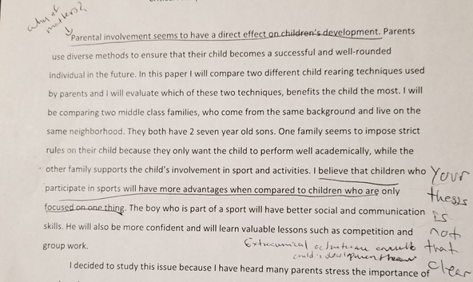
Example

Slide 6
Questions to keep in mind when revising:
Is the writing clear? Does it make sense?
Is there enough information explaining ideas?
Did you include unneccessary information that confuses the readers?
Do the ideas in the essay flow in a logical order?

Slide 7
Works Cited
(Writers On Revising,n.d), Retrieved on November 27,2018 (https://writingcommons.org/writers-on-revising)

